Slide 1
EU-US-JP ITS Steering Group Annual Meeting 2018
CEPT/ECC Activities on ITS
Thomas Weilacher Chairman ECC Working Group FM
Copenhagen, 20 September 2018
1

Slide 4
Current spectrum regulations
Frequency range | Usage | Regulation
5 905 MHz to 5 925 MHz | Future ITS applications | ECC Decision (08)01
5 875 MHz to 5 905 MHz | ITS safety (not limited to road safety In ECC Decision (08)01) | ECC Decision (08)01 EC Decision 2008/771/EC
5 855 MHz to 5 875 MHz | ITS non-safety applications | ECC Recommendation(08)01
In addition:
ECC Decision (09)01 (ERC/REC 70-03 - Annex 13) and EC DEC 2006/771/EC (amended by (EU) 2017/1483) for ITS in 63-64 GHz including hybrid radar and vehicle communications systems;
SRD regulation in ERC/REC 70-03 - Annex 1 and EC DEC 2006/771/EC (amended by (EU) 2017/1483) for 5725 - 5875 MHz;
Road Tolling: 5795-5815 MHz incl. in ERC/REC 70-03 - Annex 5 and EC Decision 2006/771/EC (amended by (EU) 2017/1483) for SRD;
Existing compatibility studies for 5.9 GHz ITS are mainly in ECC Reports 101 and 228; and now in (draft) ECC Report 290.

Slide 5
EC Mandates
EC Mandate to CEPT to study the extension of the Intelligent Transport Systems (ITS) safety-related band at 5.9 GHz
Extending the upper edge of the EC harmonised safety-related ITS band (5875-5905 MHz) by 20 MHz up to 5925 MHz;
In addition to road transport, allowing other means of transport such as Urban Rail using Communication Based Train Control (CBTC) in the EC harmonised safety-related ITS band.
Permanent EC Mandate to CEPT on SRD (currently 7th update)
Concerns non-safety related ITS in 5855-5875 MHz;
Concerns new Smart Tachograph, Weight and Dimensions Applications in 5795 – 5815 MHz (so far available for road tolling);
Concerns also ITS in 60 GHz.
Responses CEPT Report 71 (ITS) and CEPT Report 70 (SRD) for Public Consultation Approval in October 2018 at CEPT/ECC.

Slide 6
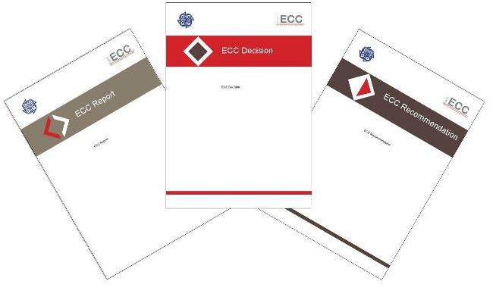
Planned Output
CEPT Reports 70 and 71 – Proposals for modification of related Commission Implementing Decisions (to be discussed within DG Connect / Radio Spectrum Committee meetings).
Revision ECC Decision (08)01 – ITS (safety-related) in 5875-5925/5935 MHz.
Revision ECC Recommendation (08)01 – ITS (non-safety) in 5855-5875 MHz.
Inclusion in ERC/REC 70-03, e.g. Smart Tachograph and Weight and Dimension applications.
Revision ECC Decision (09)01 on ITS in 63 – 64 GHz (part of the review of the band 57 – 71 GHz).

Slide 7
Technologies under Consideration
Road ITS - ITS-G5 and LTE-V2X. LTE-V2X uses in the 5.9 GHz band only the PC5 air interface. ITS-G5 is based on IEEE 802.11/11p specifications.
Urban Rail (CBTC) ITS: DSSS/TDMA, full or modified IEEE 802.11 technology, OFDM based, 3GPP TD-LTE (used in China at 1.8 GHz, not implemented in Europe yet).

Slide 8
Organisation & Timeline
24 - 28 September 2018 – WG FM #92 Finalisation of draft CEPT Reports 70 and 71.
23 - 26 October 2018 – ECC#49 Approval for public consultation of draft CEPT Reports 70 and 71.
05 – 06 December 2018 – RSC#66 Introduction of draft CEPT Reports 70 and 71, first discussions.
19 - 21 December 2018 – SRD/MG#75 Comments resolution meeting after PC.
04 – 08 February 2019 – WG FM #93 Finalisation of amended draft CEPT Reports 70 and 71 after PC.
05 – 08 March 2019 – ECC #50 Final approval of CEPT Reports 70 and 71, submission to the European Commission (DG Connect).

Slide 9
Conclusions of draft CEPT Report 71 on ITS
Draft CEPT Report 71 is available (Annex 14 to doc. FM(18)143): https://www.cept.org/ecc/groups/ecc/wg-fm/client/meeting-documents/
Changes are still possible until the final approval (March 2019).
Major outcome:
Road ITS and Urban Rail ITS applications should be part of the same regulatory framework.
Urban Rail ITS applications are currently using frequencies in 5905-5935 MHz, Road ITS applications in 5875-5905 MHz.

Slide 10
Conclusions of draft CEPT Report 71 on ITS
Major outcome (cont.):
FS applications are widespread above 5925 MHz, and therefore Road ITS applications are not considered above 5925 MHz unless a proper study is performed.
The frequency regulation should ensure technology neutrality, enable early launch of ITS products, yet take special care to avoid one technology preempt all the spectrum or interfere other technologies until ETSI agrees on a proper sharing mechanism compatible with early launched technologies.
Defining priority between different ITS applications is not against the principle of technology neutrality. Road ITS and Urban Rail ITS should remain confined to their respective prioritised frequency range until they implement a proper sharing mechanism defined by ETSI.

Slide 11
Conclusions of draft CEPT Report 71 on ITS
Major outcome (cont.):
The frequency band 5875-5925 MHz shall be designated to all safety-related ITS applications. In addition, the frequency band 5925-5935 MHz shall be designated for safety-related Urban Rail ITS applications.
The regulatory framework shall define priority to Road ITS applications in the frequency range 5875-5915 MHz and to Urban Rail ITS applications in 5915-5935 MHz, so that no harmful interference shall be caused to the application having priority.

Slide 12
Conclusions of draft CEPT Report 71 on ITS
Major outcome (cont.):
In absence of solutions which allow Road ITS applications to ensure the protection of Urban Rail ITS applications in the frequency range 5915-5925 MHz, Road ITS applications in 5915-5925 MHz should be allowed and initially be limited to vehicle-to-infrastructure (V2I) applications; Vehicle-to-vehicle (V2V) could be permitted when solutions ensuring protection of Urban Rail ITS become available from standardisation in ETSI.
The precise way how this can be best facilitated for Urban Rail ITS is within the national authorisation process based on national coordination. This can imply the use of individual authorisations for infrastructure-based Urban Rail ITS (5915-5935 MHz), Road ITS (5915-5925 MHz) and FS (above 5925 MHz).

Slide 13
Conclusions of draft CEPT Report 71 on ITS
Major outcome (cont.):
CEPT is suggesting reviewing the EU framework after no more than 3 years, taking into account the progress made on technology-neutral co-channel sharing mechanisms between ITS applications.
CEPT invited ETSI to develop sharing and interference mitigation techniques with a reasonable time-frame (no more than 3 years), for ensuring co-channel coexistence in the frequency range 5875-5925 MHz between Road ITS and Urban Rail applications and between Road ITS radio technologies.
Technical conditions to be defined by CEPT for RLAN operating above 5935 MHz (response to RLAN Mandate still under development), to ensure protection of safety-related Urban Rail applications below 5935 MHz and safety-related Road ITS below 5925 MHz (e.g. out-of-band emission limit, and blocking scenario).

Slide 14
Finally..
Thank you very much
Further information on: www.cept.org/ecc

